Slide 1
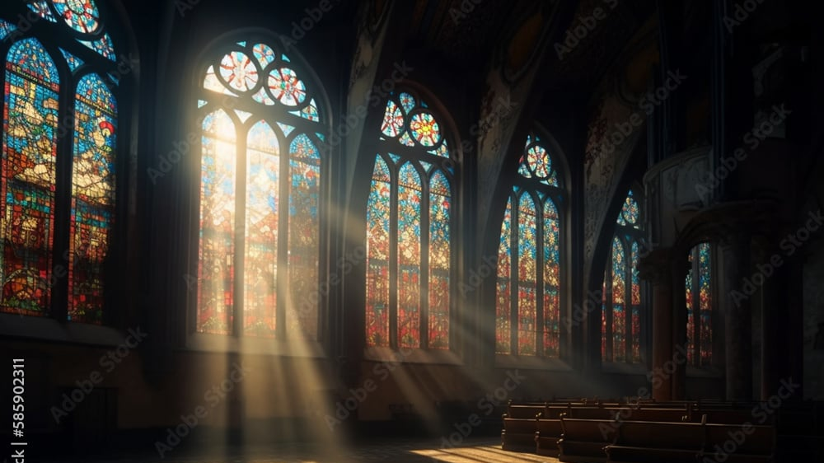
The Greatness of God
Dr. Keith Evan Schubert

Slide 2



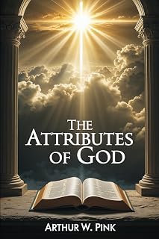


Slide 3
Plan
8/19 Thinking about Trinity Intro
8/26 God before Creation Ch 1
9/2 Father Overflows Ch 2
9/9 Son Saves Ch 3
9/16 Spirit Beautifies Ch 4
9/23 Who is like you? Ch5 & Conclusion
9/30 Attributes of God Handout 1
10/7 Holiness of God Handout 2
10/14 Sovereignty of God Handout 3
10/21 Theophanies Handout 4

Slide 4
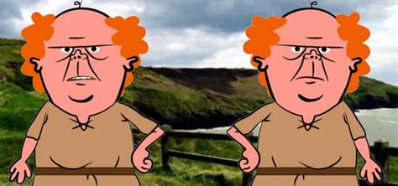
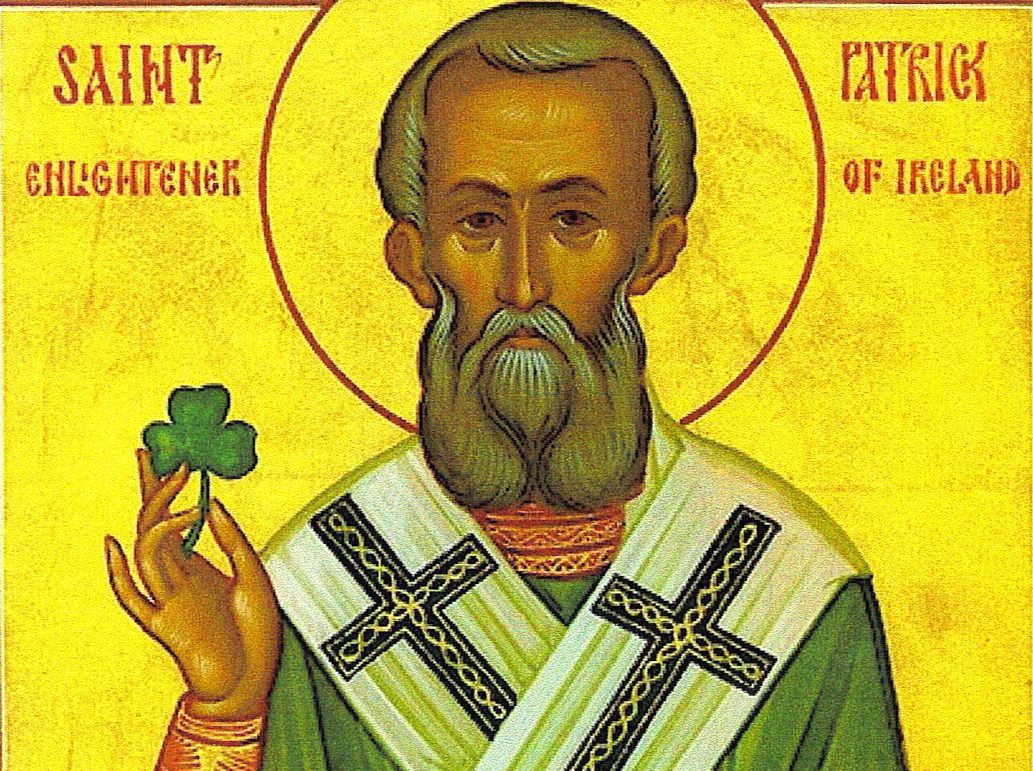
Wrong ways
Detached facts
Our own understanding
Simplified versions
Other religions
Bad analogies
https://www.youtube.com/watch?v=KQLfgaUoQCw

Slide 5
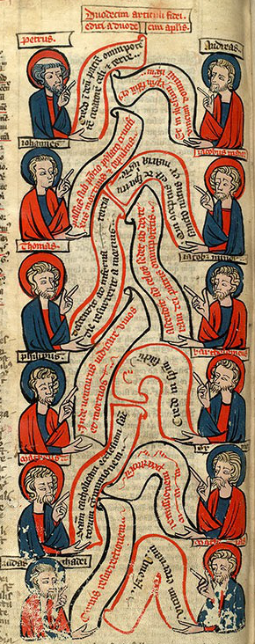

I believe in God, the Father almighty,
creator of heaven and earth.
I believe in Jesus Christ, his only Son, our Lord.
He was conceived by the power of the Holy Spirit
and born of the Virgin Mary.
He suffered under Pontius Pilate, was crucified, died,
and was buried.
He descended to the dead.
On the third day he rose again.
He ascended into heaven,
and is seated at the right hand of the Father.
He will come again to judge the living and the dead.
I believe in the Holy Spirit,
the holy Catholic Church, the communion of saints,
the forgiveness of sins,
the resurrection of the body,
and the life everlasting. Amen.
Apostles' Creed
Notes:
Nicean Creed
I believe in one God,
the Father almighty,
maker of heaven and earth,
of all things visible and invisible.
I believe in one Lord Jesus Christ,
the Only Begotten Son of God,
born of the Father before all ages.
God from God, Light from Light,
true God from true God,
begotten, not made, consubstantial with the Father;
through him all things were made.
For us men and for our salvation
he came down from heaven,
and by the Holy Spirit was incarnate of the Virgin Mary,
and became man.
For our sake he was crucified under Pontius Pilate,
he suffered death and was buried,
and rose again on the third day
in accordance with the Scriptures.
He ascended into heaven
and is seated at the right hand of the Father.
He will come again in glory
to judge the living and the dead
and his kingdom will have no end.
I believe in the Holy Spirit, the Lord, the giver of life,
who proceeds from the Father and the Son,
who with the Father and the Son is adored and glorified,
who has spoken through the prophets.
I believe in one, holy, catholic and apostolic Church.
I confess one Baptism for the forgiveness of sins
and I look forward to the resurrection of the dead
and the life of the world to come.
Amen.

Slide 6
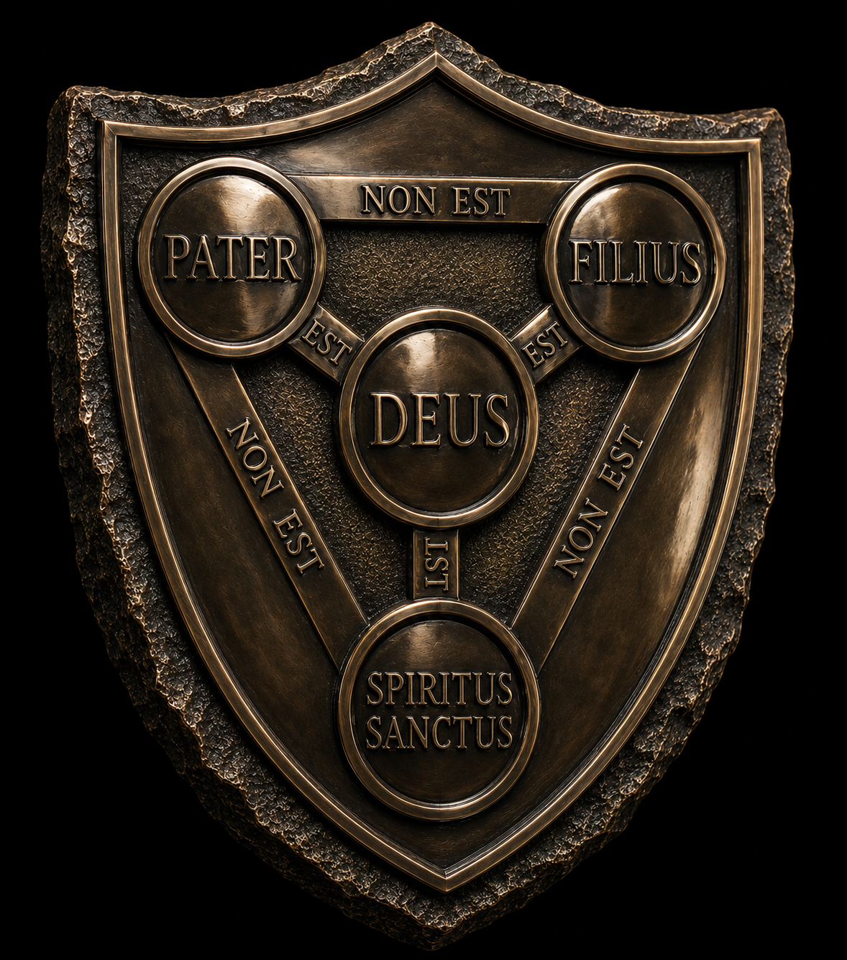
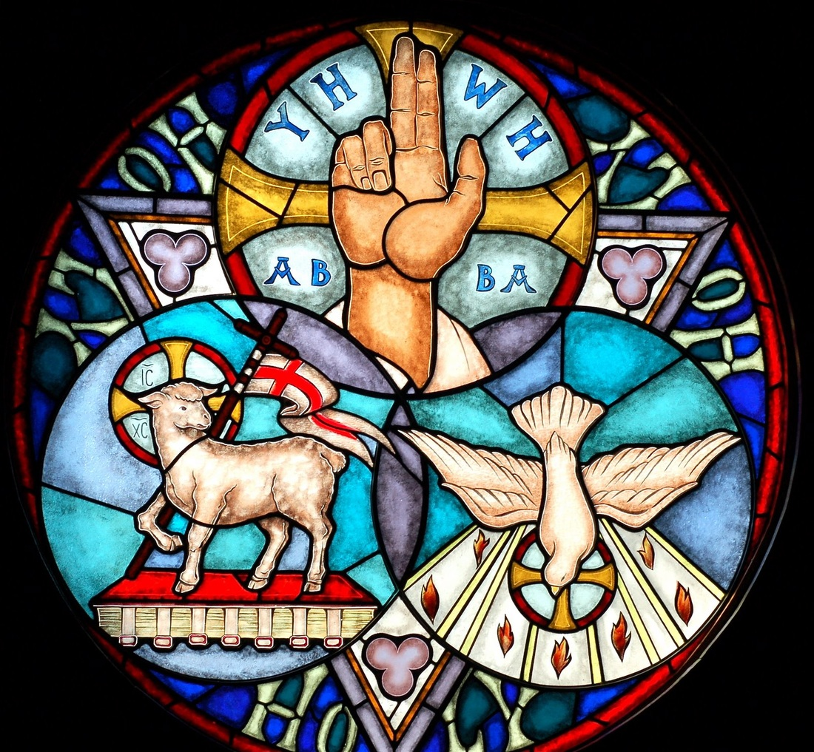

Slide 7
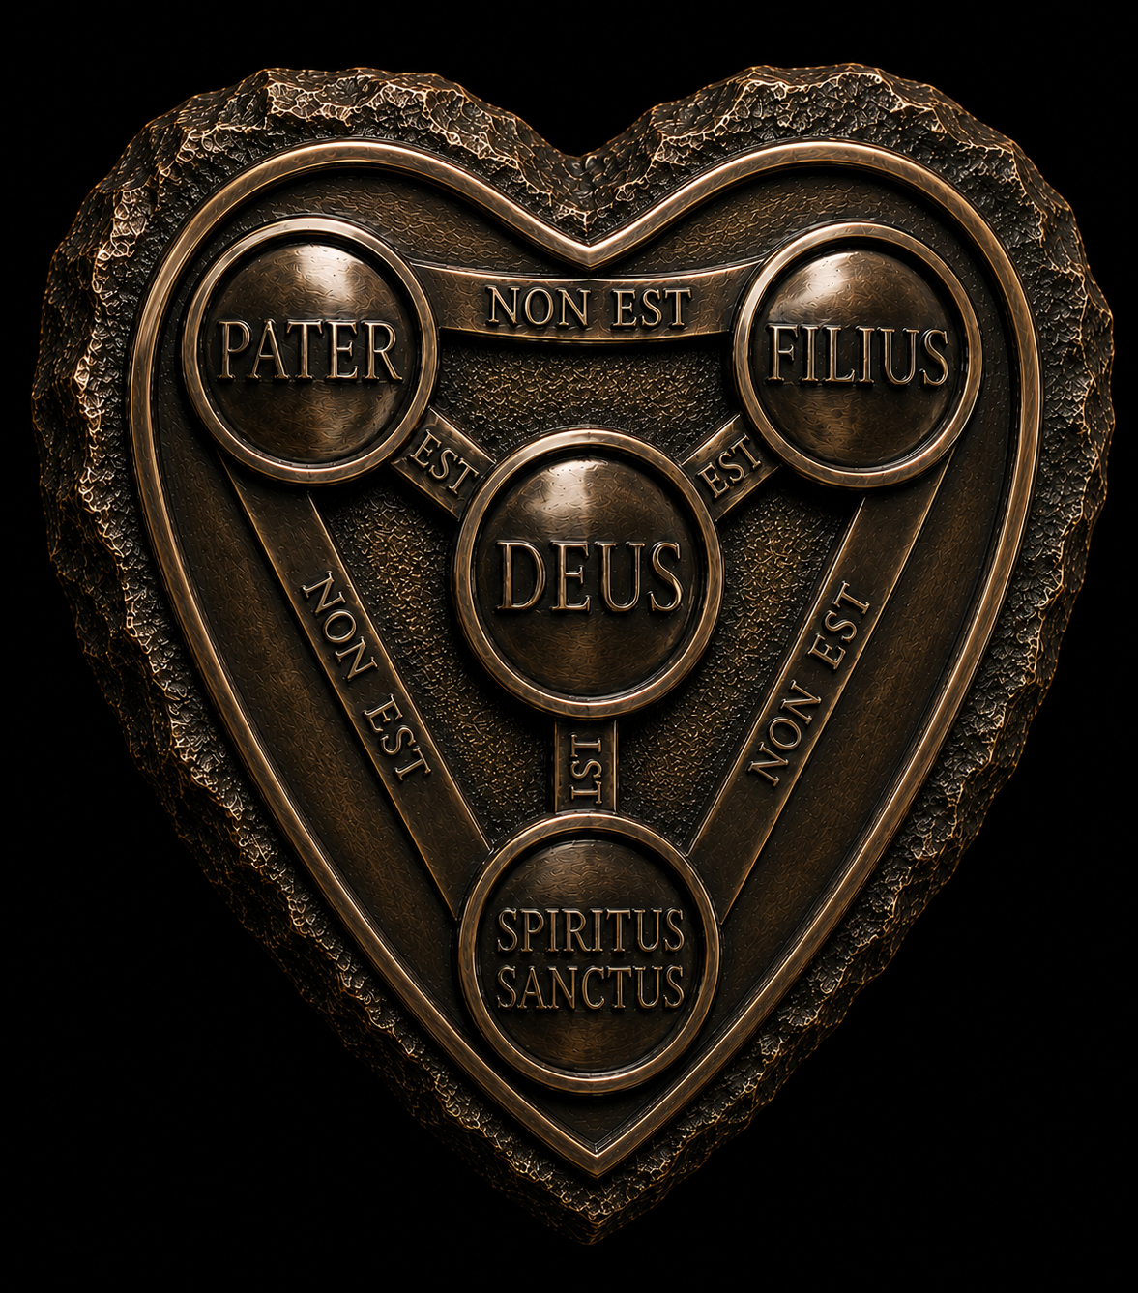

Slide 8
Fear of the Lord
Exodus 20:18-20
Jeremiah 33:8-9
Genesis 28:10-17

Slide 9
Beauty of God
Ezekiel 1
Isaiah 6
Revelation 1, 4, 5
John 12

Slide 10
Glory
Ezekiel 1:26 -28
Ezekiel 10:4
Isiah 60:1
Psalm 19:1
Job 37:22
Luke 2:8
Hebrews 1:1-4
Revelation

