Slide 1
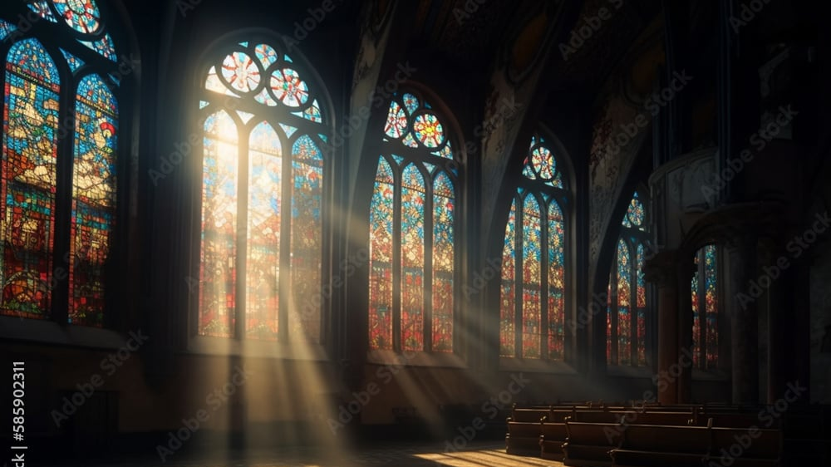
The Greatness of God
Dr. Keith Evan Schubert

Slide 2
Plan
8/19 Thinking about Trinity Intro
8/26 God before Creation Ch 1
9/2 Father Overflows Ch 2
9/9 Son Saves Ch 3
9/16 Spirit Beautifies Ch 4
9/23 Who is like you? Ch5 & Conclusion
9/30 Attributes of God Handout 1
10/7 Holiness of God Handout 2
10/14 Sovereignty of God Handout 3
10/21 Theophanies Handout 4

Slide 3
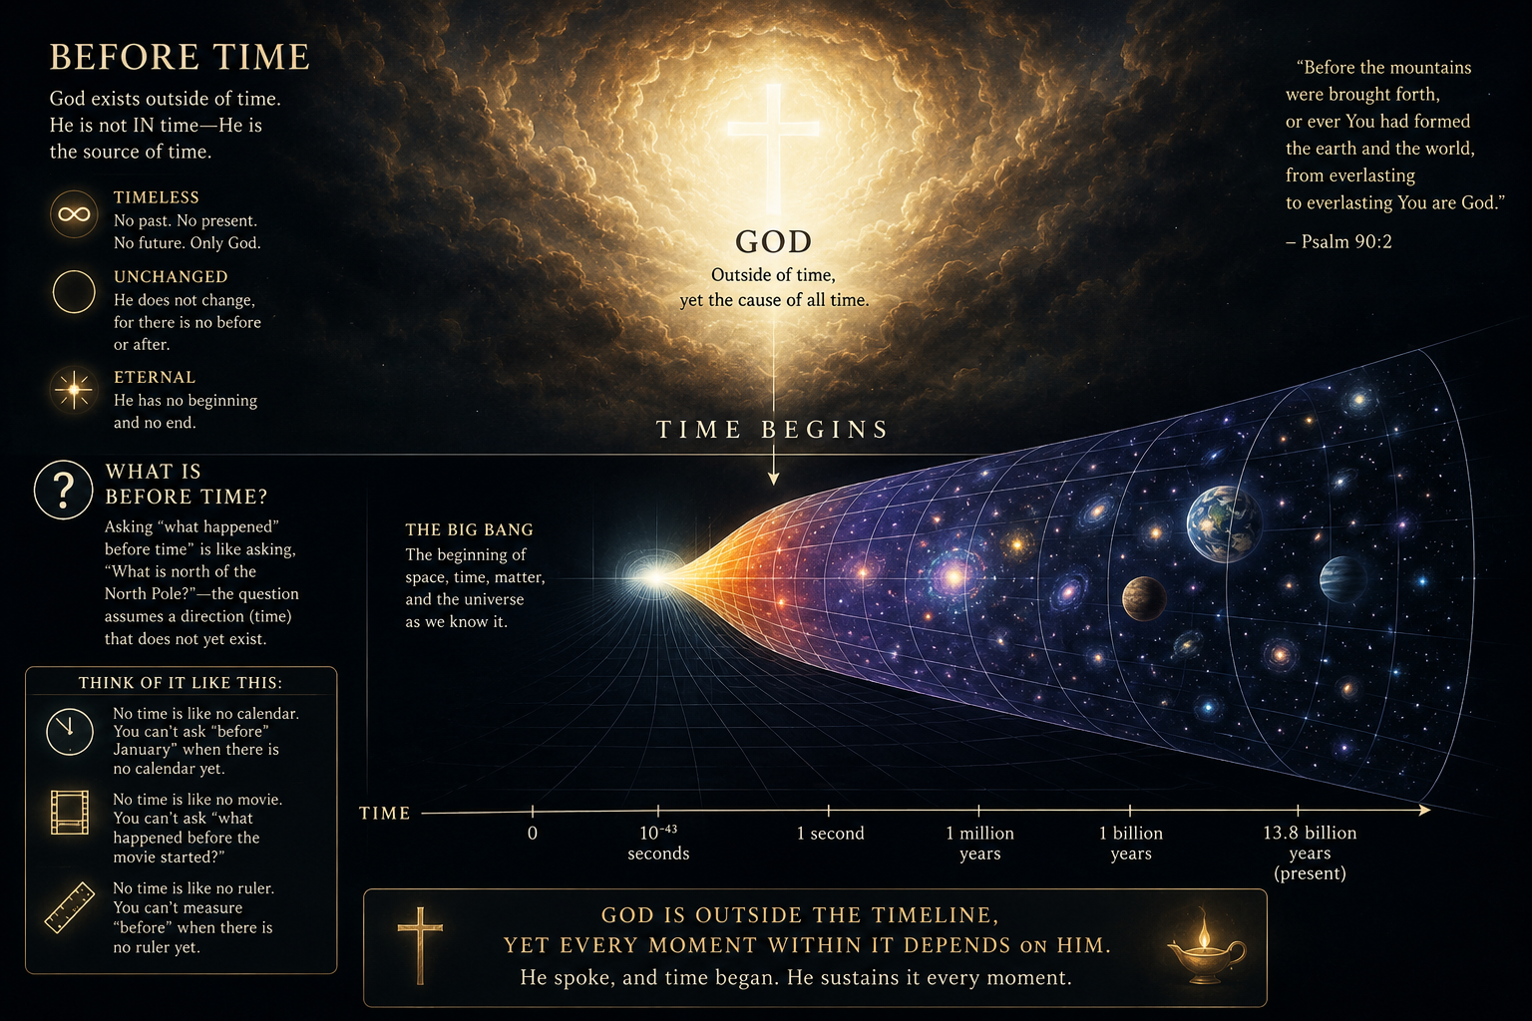
Before Creation
Genesis 1:1
John 1:1
Psalm 90:2
Colossians 1:17
Job 38:4
John 17:5,24
Titus 1:2
Ephesians 1:4

Slide 4
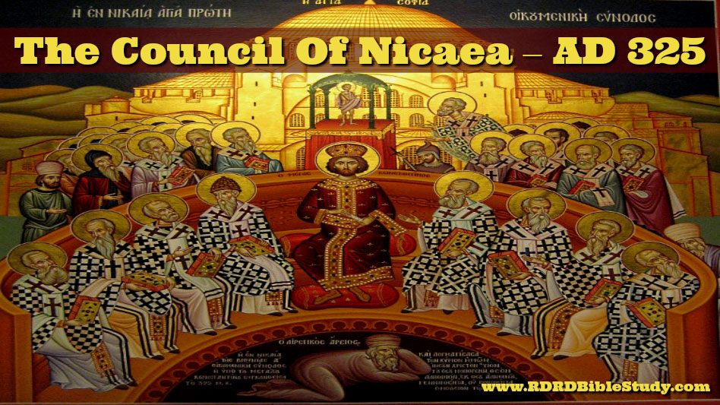
Nicene Creed
We believe in one God,
the Father almighty,
maker of heaven and earth,
of all things visible and invisible.
And in one Lord Jesus Christ,
the only Son of God,
begotten from the Father before all ages,
God from God,
Light from Light,
true God from true God,
begotten, not made;
of the same essence as the Father.
Through him all things were made.
For us and for our salvation
he came down from heaven;
he became incarnate by the Holy Spirit and the virgin Mary,
and was made human.
He was crucified for us under Pontius Pilate;
he suffered and was buried.
The third day he rose again, according to the Scriptures.
He ascended to heaven
and is seated at the right hand of the Father.
He will come again with glory
to judge the living and the dead.
His kingdom will never end.
Nicene Creed
And we believe in the Holy Spirit,
the Lord, the giver of life.
He proceeds from the Father and the Son,
and with the Father and the Son is worshiped and glorified.
He spoke through the prophets.
We believe in one holy catholic and apostolic church.
We affirm one baptism for the forgiveness of sins.
We look forward to the resurrection of the dead,
and to life in the world to come. Amen.

Slide 5
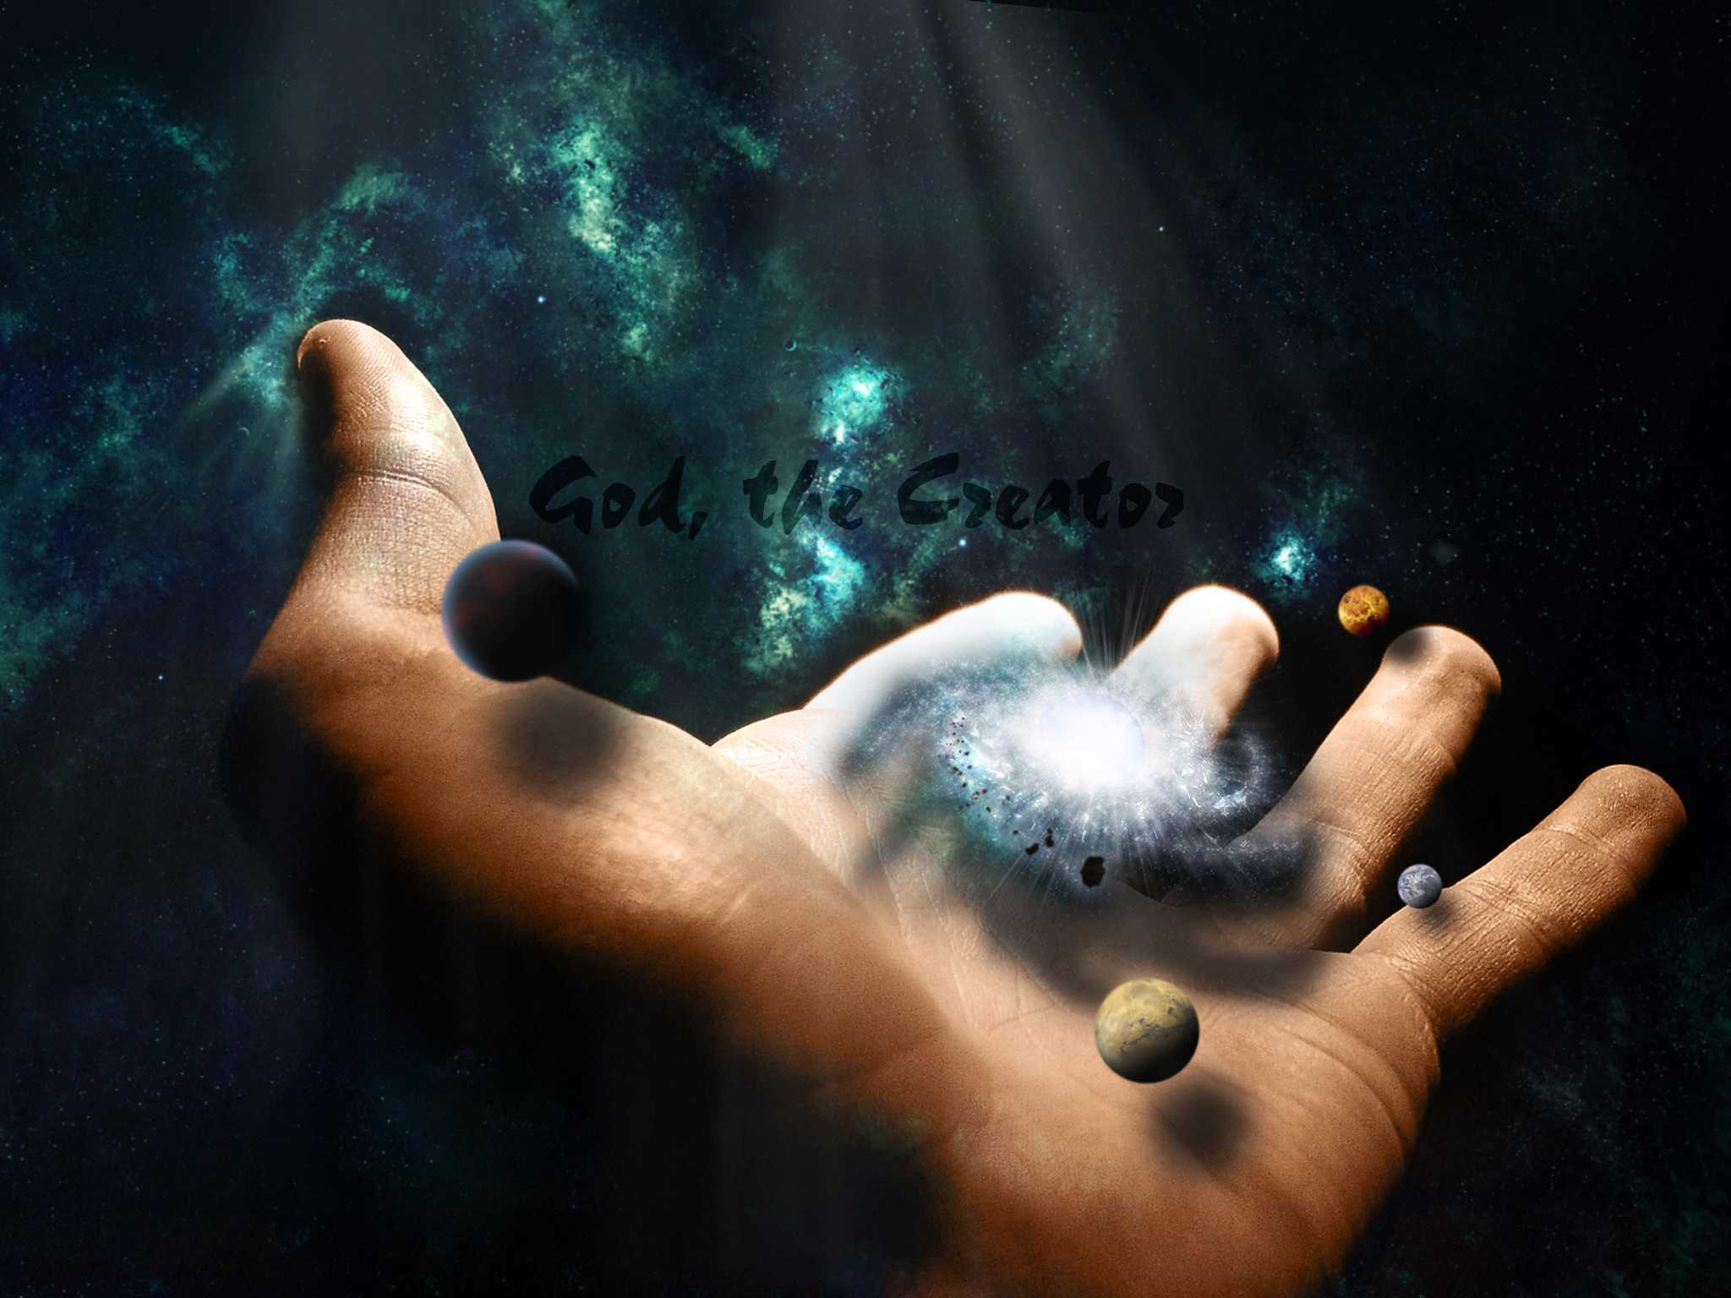
Creator
Genesis 1:1-2
Psalm 19:1-4
Nehemiah 9:6
Isaiah 45:18
Jeremiah 10:12
Romans 1:18-20
Revelation 4:11

Slide 6
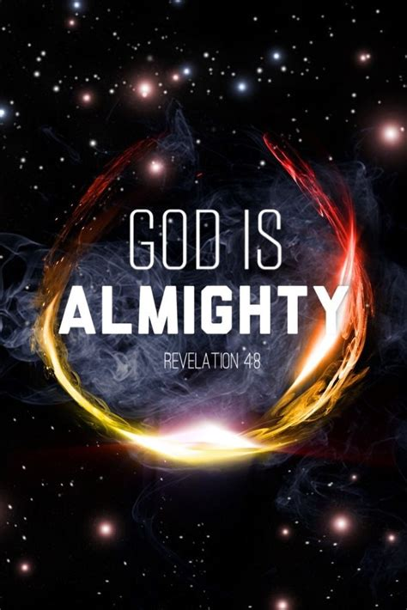
Almighty
Psalm 80:19
Psalm 91:1-2
1 Chronicles 29:11-12
Jeremiah 32:17-27
Revelation 1:8
Revelation 4:8

Slide 7
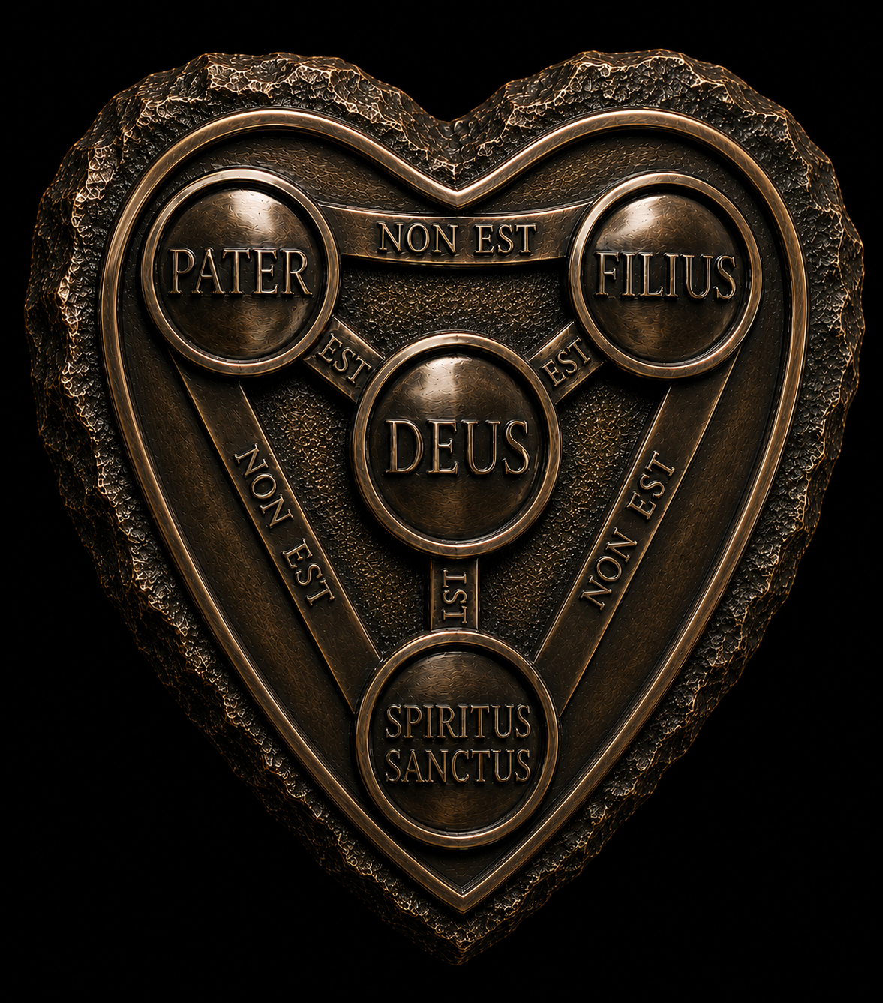
Father
Psalm 103:13
Proverbs 30:1-4
Matthew 6:26
John 1:1-5
1 Corinthians 8:6
2 Corinthians 1:3-4
Col 1:3-23
Hebrews 1:1-4
Isaiah 64:8
Proverbs 3:11-12
Hebrews 11:6
John 3:16
John 4:24
John 20:31
1 John 4:8
1 John 3:1
James 1:17
1 Timothy 1:17
Romans 8:37-39
Ephesians 1:3-14

