Slide 1
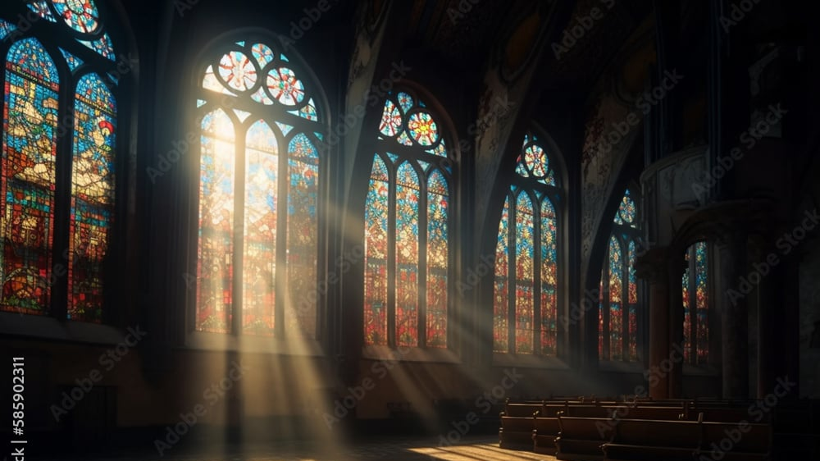
The Greatness of God
Dr. Keith Evan Schubert

Slide 2
Plan
8/19 Thinking about Trinity Intro
8/26 God before Creation Ch 1
9/2 Father Overflows Ch 2
9/9 Son Saves Ch 3
9/16 Spirit Beautifies Ch 4
9/23 Who is like you? Ch5 & Conclusion
9/30 Attributes of God Handout 1
10/7 Holiness of God Handout 2
10/14 Sovereignty of God Handout 3
10/21 Theophanies Handout 4

Slide 3
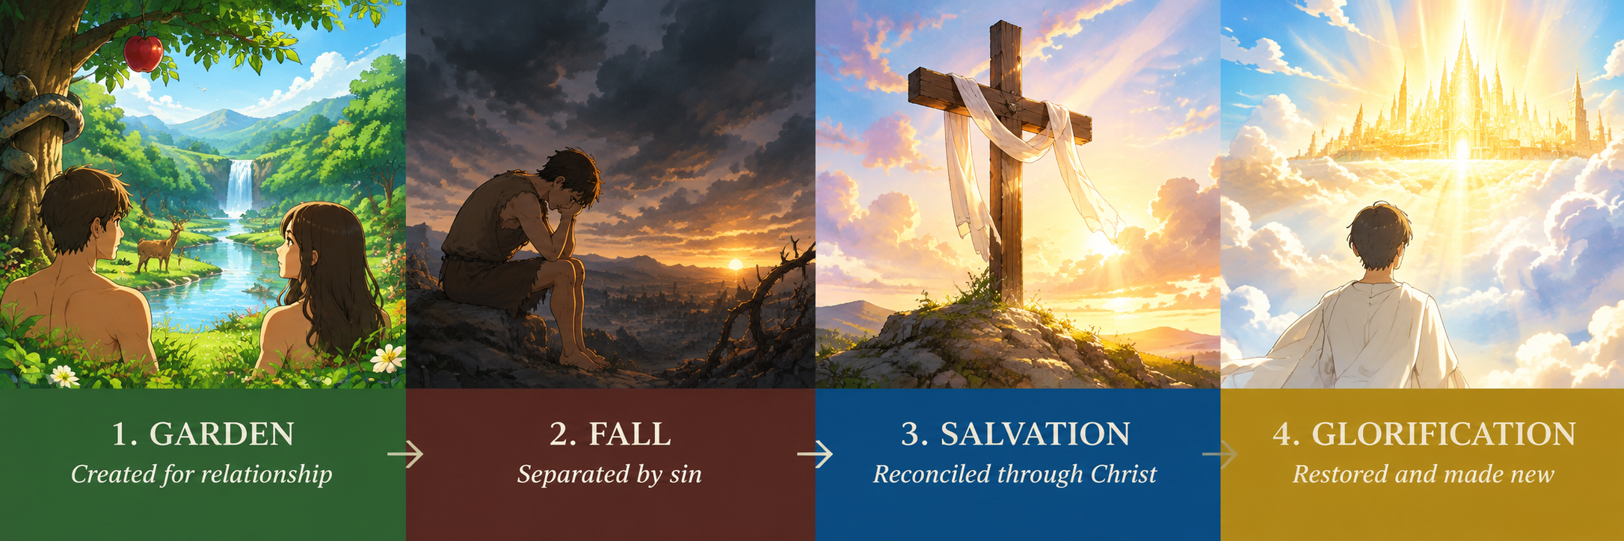
Sin and Salvation
Matthew 22:34-40
James 1:13-15
Genesis 1:26-31
Genesis 3:1-13
Ezekiel 28:1-19
Romans 8:1-17
Ephesians 2
1 Cor 15:35-58
1 John 3:1-10

Slide 4
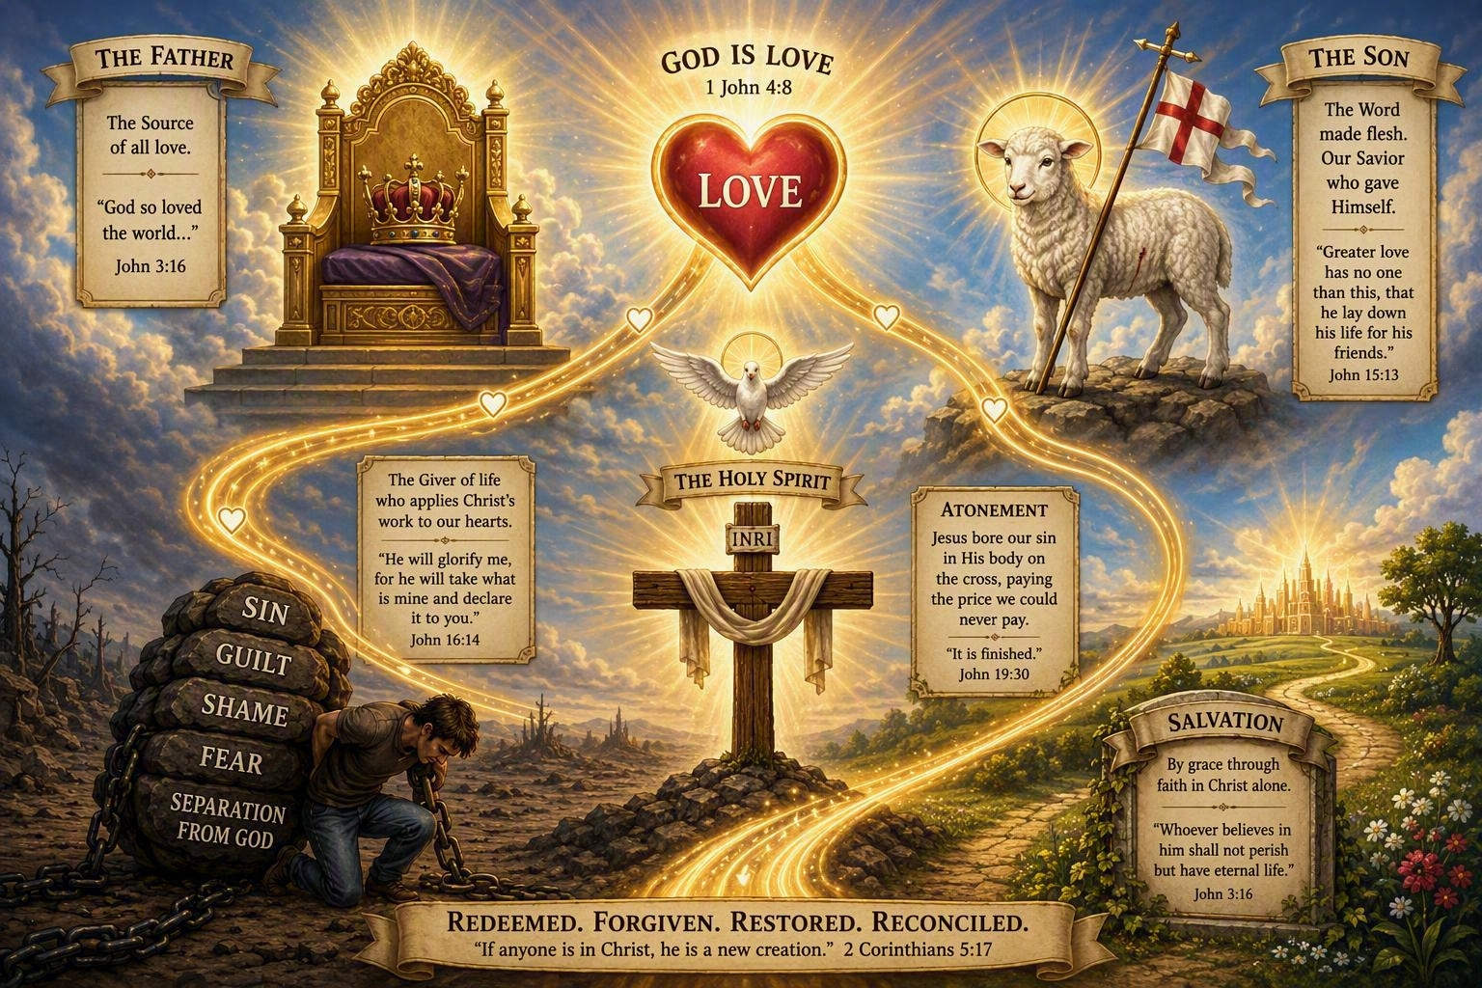
Nature of Salvation
Love
  John 3:16
  1 John 3:16
  1 John 4:8-10
  John 10:14-18
Glory
  John 17
  Isaiah 42:1-8
Incarnation & Atonement
  Hebrews 2:14-18
  Hebrews 10:1-25
Brotherhood
  Psalm 133

Slide 5
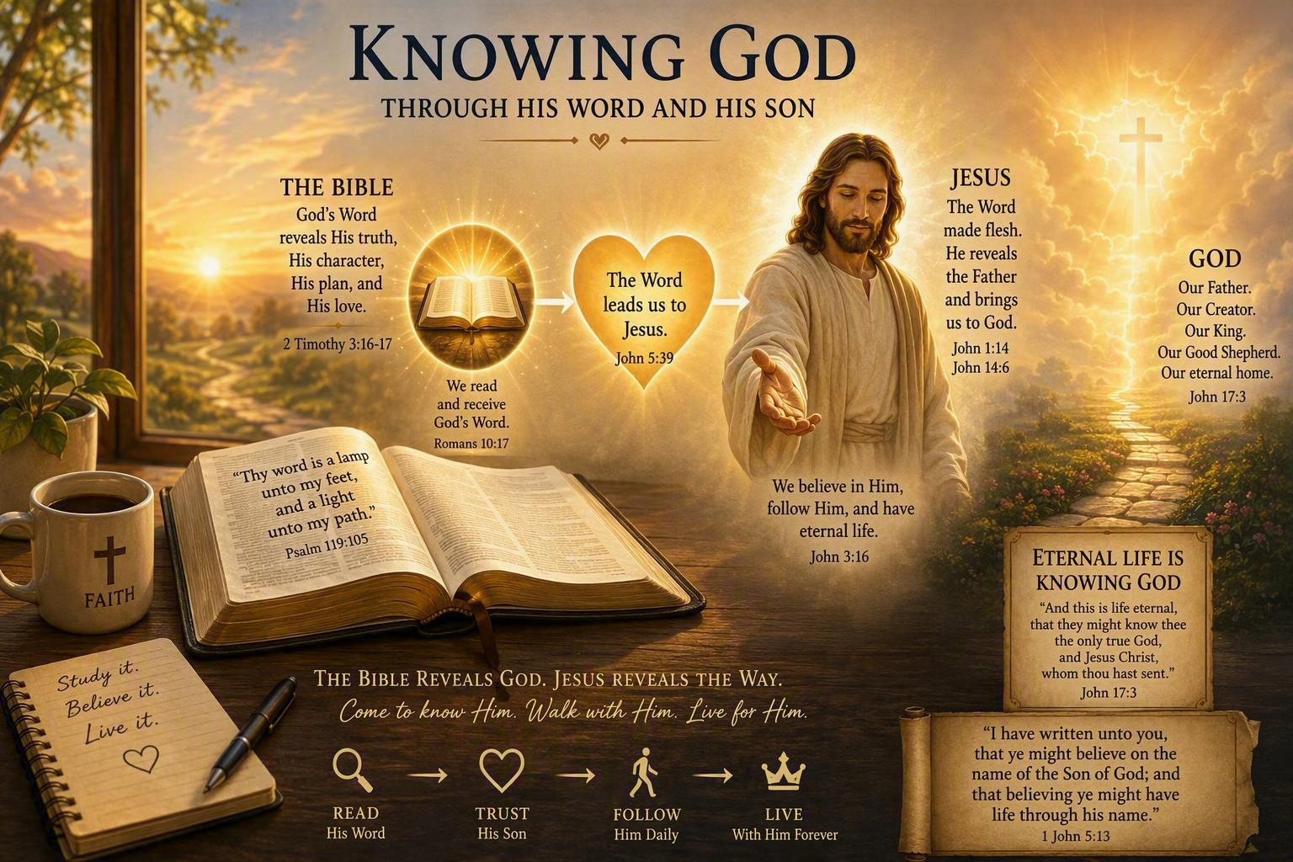
Knowing God
Jesus knows & reveals
  Matthew 11:25-30
  John 1:14-18
Jesus is image
  Colossians 1:15-20
  Hebrews 1:1-4
  John 14:5-11
Scripture
  2 Tim 3:14-17
  1 Peter 1:11-12
  Romans 10:16-18
  Colossians 3:15-17

