Slide 1
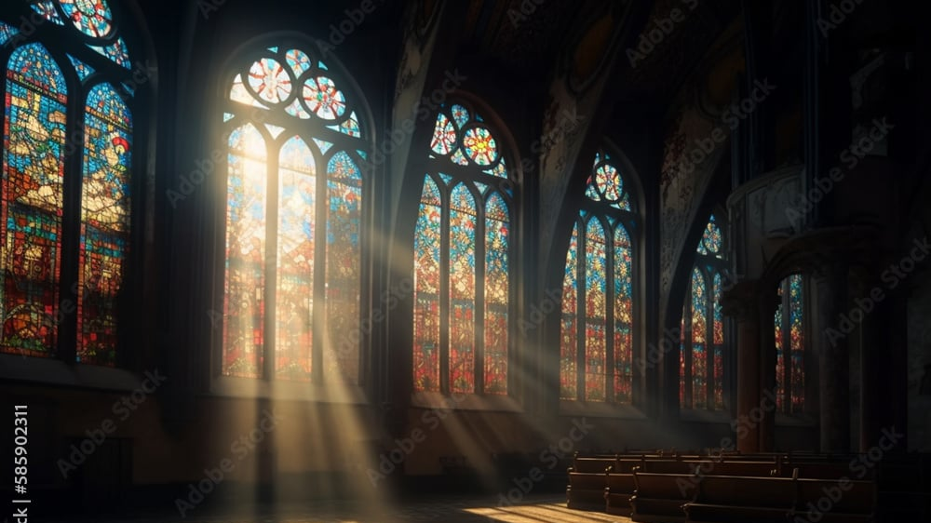
The Greatness of God
Dr. Keith Evan Schubert

Slide 2
Plan
8/19 Thinking about Trinity Intro
8/26 God before Creation Ch 1
9/2 Father Overflows Ch 2
9/9 Son Saves Ch 3
9/16 Spirit Beautifies Ch 4
9/23 Who is like you? Ch5 & Conclusion
9/30 Attributes of God Handout 1
10/7 Holiness of God Handout 2
10/14 Sovereignty of God Handout 3
10/21 Theophanies Handout 4

Slide 3
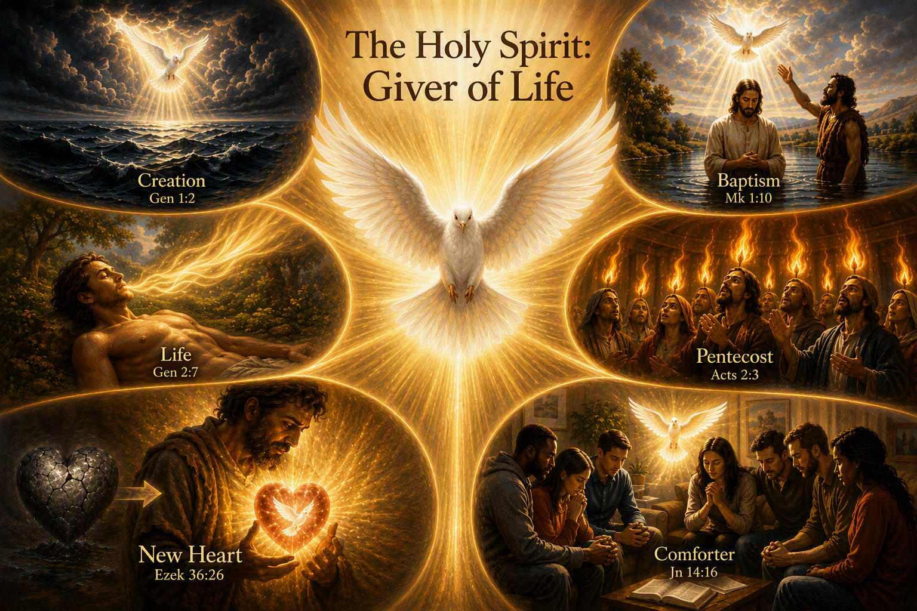
Spirit of Life
Genesis 1:1-2
Genesis 2:7
Psalm 104:30
Ezekiel 36:26-28
Ezekiel 37:1-14
Luke 1:35
Matthew 1:18-20
John 3:4-8
John 6:59-71 (63)
Romans 1:1-6
John 20:21-22
Acts 2:1-13

Slide 4
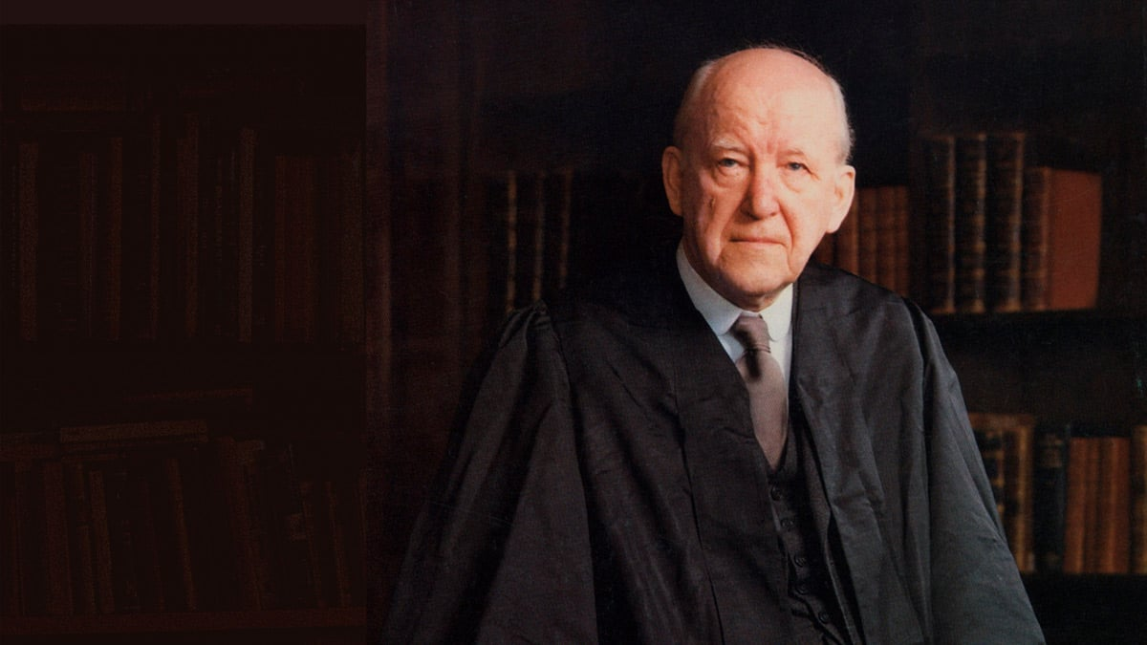
Praying through the Spirit
Welcome/relax
  Hebrews 10:11-25
  Philippians 4:1-9
Equipped
  Ephesians 6:10-20
Assisted
  Romans 8:9-39
Ask In Jesus
  John 16:23-33
  John 15:1-11
Lifestyle
  1 Thes. 5:12-25
Disciples’ Prayer
  Matthew 6:5-15
We all know what it is to feel deadness in prayer, difficulty in prayer, to be tongue-tied, with nothing to say, as it were, having to force ourselves to try. Well, to the extent that is true of us, we are not praying in the Spirit.
(Martyn Lloyd-Jones, Living Water: Studies in John 4, 99)

Slide 5
Fellowship & Family
With Trinity
  John 14:16-31
  2 Corinthians 13:14
  1 John 4:10-12
With each other
  Ephesians 2
  Ephesians 4:3-6
  John 17:13-26
  John 15:12-17
  Philippians 1:27-2:18
  Ephesians 2:18-19
  1 John 1
  1 Cor 12:4-30
Believer 1
Devil
God
Believer 2

