Slide 1
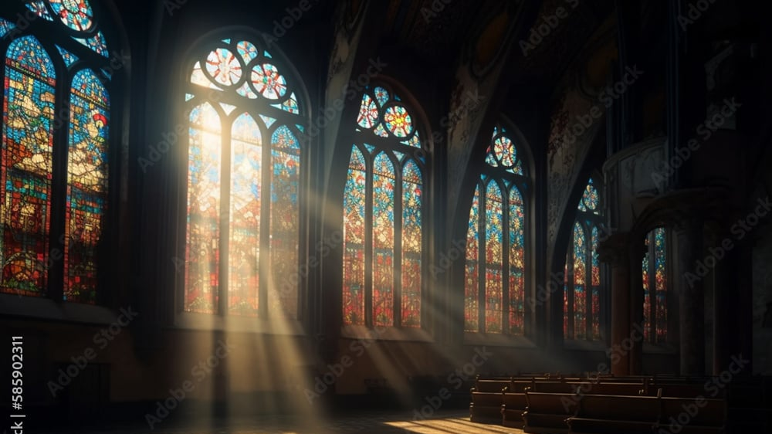
The Greatness of God
Dr. Keith Evan Schubert

Slide 2
Plan
8/19 Thinking about Trinity Intro
8/26 God before Creation Ch 1
9/2 Father Overflows Ch 2
9/9 Son Saves Ch 3
9/16 Spirit Beautifies Ch 4
9/23 Who is like you? Ch5 & Conclusion
9/30 Attributes of God Handout 1
10/7 Holiness of God Handout 2
10/14 Sovereignty of God Handout 3
10/21 Theophanies Handout 4

Slide 3
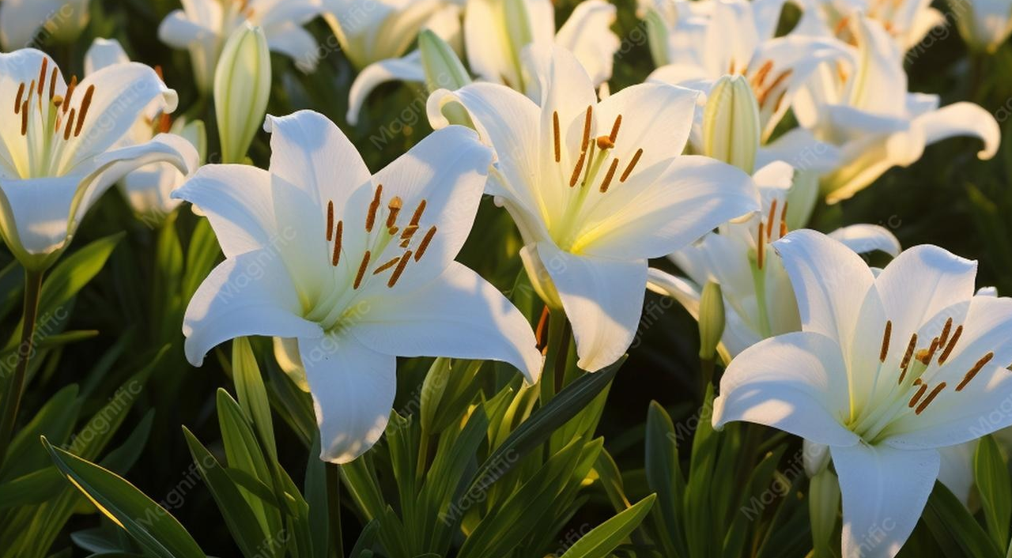
Holiness and Beauty
In the beauty of the lilies Christ was born across the sea,
With a glory in His bosom that transfigures you and me.
As He died to make men holy, let us die to make men free,
While God is marching on.
Psalm 29
Psalm 96
Psalm 110
1 Chronicles 16:29
2 Chronicles 20:21

Slide 4

Salvation, Joy, Worship, … and Wrath?
Ephesians 1
Psalm 100
Psalm 84
Matthew 26:39
John 18:11
Revelation 16:19
Revelation 19
Hebrews 12:18-24

Slide 5

Jesus Glory in John
John 1:14
John 2:11
John 11:40
John 12:23-33
John 15:8
John 16:14
John 17:1-5, 10, 20-26

