Slide 1
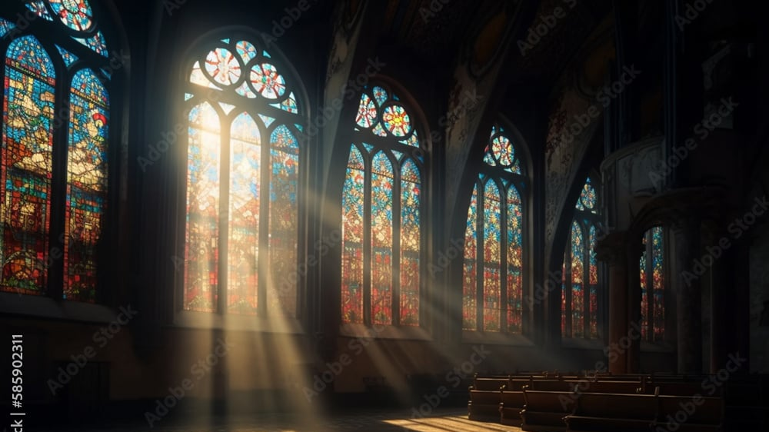
The Greatness of God
Dr. Keith Evan Schubert

Slide 2
Plan
8/19 Thinking about Trinity Intro
8/26 God before Creation Ch 1
9/2 Father Overflows Ch 2
9/9 Son Saves Ch 3
9/16 Spirit Beautifies Ch 4
9/23 Who is like you? Ch5 & Conclusion
9/30 Attributes of God Handout 1
10/7 Holiness of God Handout 2
10/14 Sovereignty of God Handout 3
10/21 Theophanies Handout 4

Slide 3
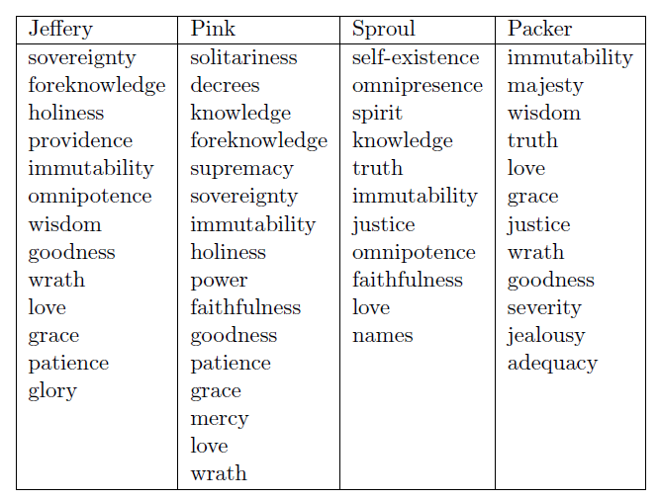
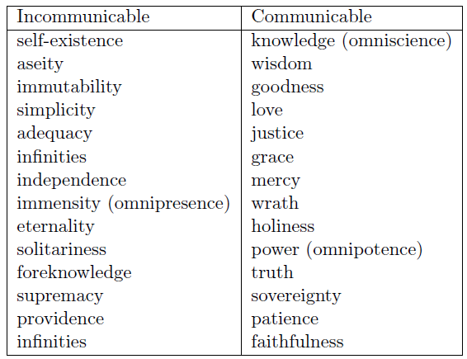
Attributes of God

Slide 4
Simplicity
1 John 4:7-12
1 John 1:5
Psalm 100:5
Jeremiah 10:10
Isaiah 40:28
Isaiah 46:9-10
Exodus 3:14
John 4:24
John 8:58
John 11:25
John 14:6
“God is uniquely unique. He is not unique as one of a kind, but unique in transcending the distinction between kind and member of a kind.”
– Stanford Encyclopedia of Philosophy

Slide 5
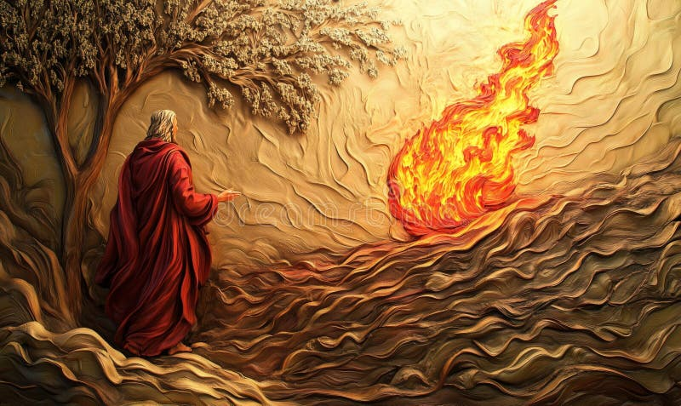
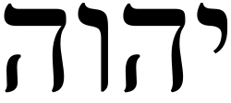
Aseity of God
From Himself
  Acts 17:24-30
  Exodus 3:1-3
  Colossians 1:15-17
  Philippians 4:19
  2 Corinthians 9:8
  Isaiah 41:10
  Isaiah 66:1–2
  Romans 8:38-39
  Romans 11:35-36
  Ephesians 2:8-9
  Psalm 50

Slide 6
Omnis of God
Omnipotence
  Job 42:1-6
  Psalm 115:3
  Numbers 11:18-23
  Numbers 23:19
  Genesis 1:3,6,9,…
  Daniel 2:21
  Ephesians 3:20
  2 Corinthians 12:9
Omnipresence
  Psalms 139:7-8
  1 Kings 8:27
  Jeremiah 23:23-24
Omniscience
  Psalm 139:4
  Psalm 147:5
  Isaiah 46:9-10
  Hebrews 4:13

