Slide 1
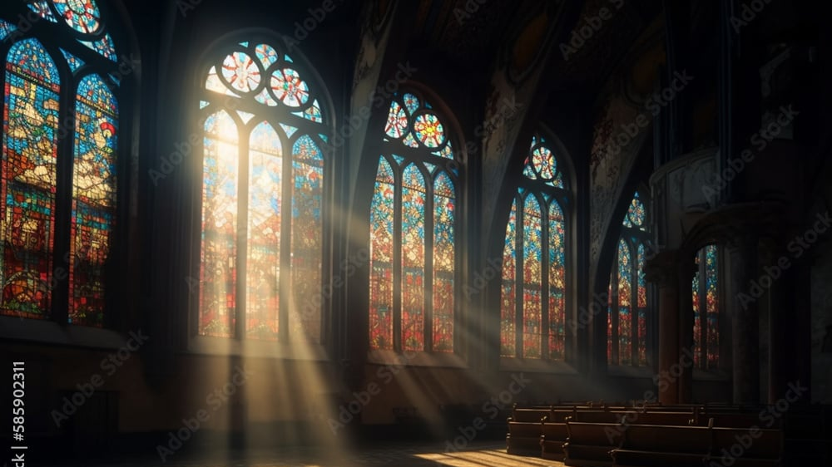
The Greatness of God
Dr. Keith Evan Schubert

Slide 2
Plan
8/19 Thinking about Trinity Intro
8/26 God before Creation Ch 1
9/2 Father Overflows Ch 2
9/9 Son Saves Ch 3
9/16 Spirit Beautifies Ch 4
9/23 Who is like you? Ch5 & Conclusion
9/30 Attributes of God Handout 1
10/7 Holiness of God Handout 2
10/14 Sovereignty of God Handout 3
10/21 Theophanies Handout 4

